Slide 1
Cloud security

Slide 2
New Risks in Cloud
•Trust and dependence
–Establishing new trust relationship between customer and cloud provider
–Customers must trust their cloud providers to respect the privacy of their data and integrity of their computations
•Security (multi-tenancy)
–Threats from other customers due to the subtleties of how physical resources can be transparently shared between virtual machines (VMs)

Slide 3
Gartner’s Seven Cloud Computing Security Risks
Privileged User Access
Regulatory Compliance & Audit
Data Location
Data Segregation
Recovery
Investigative Support
Long-term Viability

Slide 4
Privileged User Access
•Sensitive data processed outside the enterprise brings with it an inherent level of risk
•Outsourced services bypass the “physical, logical and personnel controls” of traditional in-house deployments.
• Get as much information as you can about the people who manage your data
•“Ask providers to supply specific information on the hiring and oversight of privileged administrators, and the controls over their access,” Gartner says.

Slide 5
Regulatory Compliance & Audit
•Traditional service providers are subjected to external audits and security certifications.
•Cloud computing providers who refuse to undergo this scrutiny are “signaling that customers can only use them for the most trivial functions,” according to Gartner.
•Shared infrastructure – isolation of user-specific log
•No customer-side auditing facility
•Difficult to audit data held outside organization in a cloud

Slide 6
Data Location
•Hosting of data, jurisdiction?
•Data centers: located at geographically dispersed locations
•Different jurisdiction & regulations
•Legal implications

Slide 7
Data Segregation
•Data in the cloud is typically in a shared environment alongside data from other customers.
•Encryption is effective but isn’t a cure-all. “Find out what is done to segregate data at rest,” Gartner advises.
•Encrypt data in transit, needs to be decrypted at the time of processing
–Possibility of interception
•Secure key store
–Protect encryption keys
–Limit access to key stores
–Key backup & recoverability
•The cloud provider should provide evidence that encryption schemes were designed and tested by experienced specialists.

Slide 8
Recovery
•Even if you don’t know where your data is, a cloud provider should tell you what will happen to your data and service in case of a disaster.
•“Any offering that does not replicate the data and application infrastructure across multiple sites is vulnerable to a total failure,” Gartner says. Ask your provider if it has “the ability to do a complete restoration, and how long it will take.”
•Recovery Point Objective (RPO): The maximum amount of data that will be lost following an interruption or disaster.
•Recovery Time Objective (RTO): The period of time allowed for recovery i.e., the time that is allowed to elapse between the disaster and the activation of the secondary site.
•Backup frequency

Slide 9
Investigative Support
•Investigating inappropriate or illegal activity may be impossible in cloud computing
•Monitoring
–To eliminate the conflict of interest between the provider and the consumer, a neural third-party organization is the best solution to monitor performance.

Slide 10
Long-term Viability
•“Ask potential providers how you would get your data back and if it would be in a format that you could import into a replacement application,” Gartner says.
•When to switch cloud providers ?
–Contract price increase
–Provider bankruptcy
–Provider service shutdown
–Decrease in service quality
–Business dispute
•Problem: vendor lock-in

Slide 11
Classes of Threats
Disclosure
Snooping
Deception
Modification, spoofing, repudiation of origin, denial of receipt
Disruption
Modification
Modification, spoofing, delay, denial of service

Slide 12
Security Issues in Cloud Computing
•Unique security features:
–Co-tenancy
–Lack of control on outsourced data and application
•General concerns among cloud customers [Liu’11]:
–Inadequate policies and practices
–Insufficient security controls
•Customers use cloud services to serve their clients
•Need to establish trust relationships
•Beneficial to both stakeholders

Slide 13
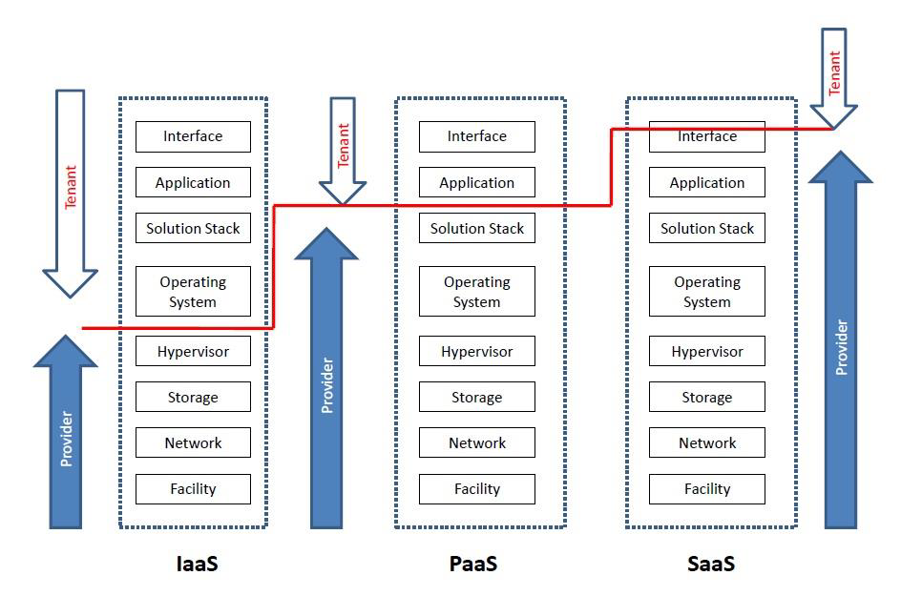
Security responsibilities in cloud

Slide 14
Security Services
Confidentiality (privacy)
Authentication (who created or sent the data)
Integrity (has not been altered)
Non-repudiation (the order is final)
Access control (prevent misuse of resources)
Availability (permanence, non-erasure)
Denial of Service Attacks
Virus that deletes files

Slide 15
Types of Attack
Social engineering/phishing
Physical break-ins, theft, and curb shopping
Password attacks
Buffer overflows
Command injection
Denial of service
Exploitation of faulty application logic
Snooping
Packet manipulation or fabrication
Backdoors

Slide 16
Security mechanisms in cloud

